Slide 1
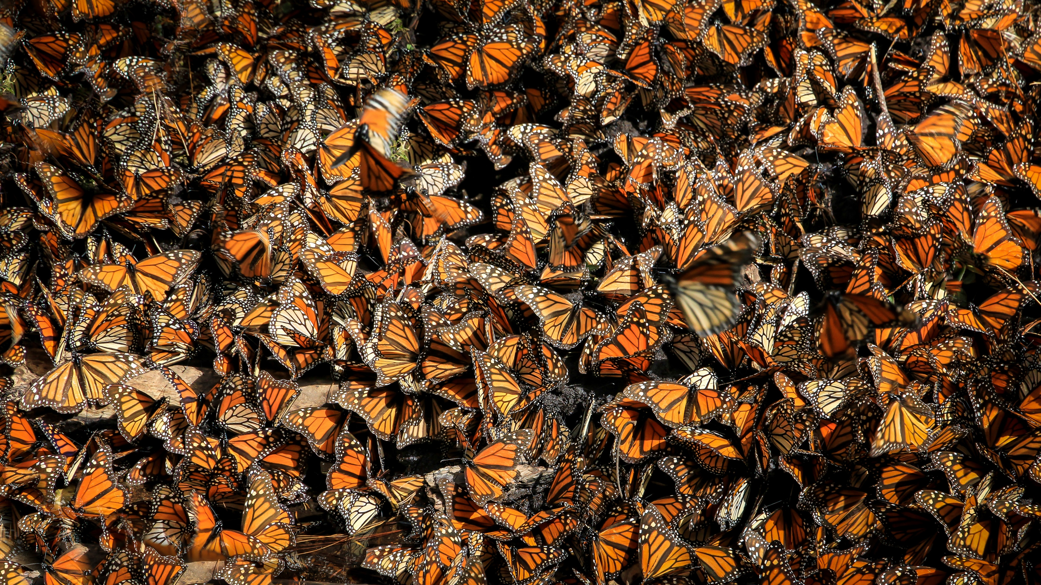
What did this Retired Couple Teach their Broker that Saved HIM from Financial Ruin?
A client saving a broker’s neck? Isn’t it supposed to be the other way around? How could a 62-year-old couple with no formal financial knowledge yank him out of the fire of financial destruction? He’s the expert, the one with all the training. Isn’t he supposed to save them?
Doing the things other advisors forget to do.
Jim and Mary had been working with Bob, their broker, for over 9 years.
They had come to rely on his judgment and he on their loyalty. But sometimes in life it’s the little things that count. And Bob had overlooked the “little” things…not only for Jim and Mary but in his own personal affairs as well.
Would it Take a Million?
There is no free lunch
Well, sometimes you can find a lunch that’s almost free. A lunch given to you so that you will listen to some information. You
know the ones. Well, Jim and Mary were hungry enough to attend this workshop. What they found out astonished them! It wasn’t about how to get a higher return or some “better” investment. It was about important things like protecting your hard-earned money from identity theft and lawsuits…how to make sure you’re taken care of medically in the manner you desire…making sure your assets pass on to your family in the way you want.
Jim’s and Mary’s eyes were opened!
It was like someone had kicked them in the stomach. They had been told that they’d taken care of all of these things by their attorney and broker! Instead they found out:
They had accidentally disinherited their grandkids
They were likely victims for identity theft
Their medical power of attorney was not current
They had no protection against lawsuits
And over 30 other things that made them extremely upset and nervous
Not my job… Man!
They immediately contacted their broker, Bob, and asked him why he hadn’t
done all these things. He said, “That’s not my job.” Jim and Mary said “well you’re our financial advisor…these affect us financially, so you should give us the advice.” His comment? “I don’t get paid to do that. I can only give investment advice.”
Or Just One*
Jim and Mary saved his donkey!
Jim and Mary told Bob all the things they needed fixed. They had lost trust in him, so they directed him, item by item, on what he needed to do to fix the gaping holes in their affairs. He did it…grudgingly. But secretly he corrected all of those things in his own personal affairs as well! It wasn’t a month later when a financial nightmare nearly hit Bob. He was spared from what would have been a crippling blow to him and his family. How? Because he secretly followed Jim and Mary’s directions line-by-line on his own personal affairs unbeknownst to them.
Did they get a thank you card? What do you think?
What does this Mumbo Jumbo mean to YOU?
We have all experienced a situation where we say…“MAN, OH, MAN, if I’d only”…one small event can have major repercussions, especially when you’re dealing with money, health or family. Just forgetting to do one thing can cause a chain of events that can rip a family apart. We wish we could turn the clock back and do it differently…but we can’t.
Unfortunately, we have yet to find an advisor that has helped their clients do ALL the things they need to do. So…we do the things other advisors forget to do!
*The Butterfly Effect—In 1960, MIT professor Edward Lorenz discovered that small variations in conditions of a dynamic situation can produce extraordinary changes in the end results of a situation. His paper presented to the New York Academy of Sciences in 1963 made the point that: A butterfly flapping its wings in Brazil can cause a tornado in Texas next month. This fact is now taught in every college physics class.
About the presenter
Add Brief Biography of Yourself Here:

Slide 2
Seating is limited
Call for your reservation
XXX-XXX-XXXX
WHEN: [Date]
TIME: [Time]
WHERE: [Address]
Presented by: [Name]
(Insert your workshop topics and bullet points below)
TOPIC
TOPIC
TOPIC
Join us at this, fun and informative get-together to learn the things other advisors forget to do when it comes to:
Could a Butterfly Cause a Tornado?

